Slide 1

Legal Wise v1.0 Fall 2015
Team members: Valeria Lopez, Amanda Chiu
Product Owner: Jaime Borras
Instructor: Professor Masoud Sadjadi

Slide 2

What is Legal Wise?
The concept of LegalWise is a web application that can facilitate legal firms to answer legal questions using artificial intelligence technologies. This application can help tremendously on saving time by filtering legal documents electronically instead of spending time looking for answers manually which is prone to errors. In this project, we are using modern technologies and cutting edge methodologies to achieve the expected outcome

Slide 3
What is the problem?
The legal system uses a great amount of human labor to accomplish tedious tasks on formatted documents. When a lawyer is looking for a case referral in order to use it on his/her current case, the staff needs to go over all the related cases and find the appropriate one that suits the circumstances. This process is time consuming and also prone to errors. This system is currently being use for years making law services very expensive and time consuming.

Slide 4
Requirements – User Stories
User ask a question to the application and the application respond with a suggestion based on files index on the server.
The response must have a reference to source files
User needs to create an account to access the application
User may edit his/her profile
User forgets his/her password
User uploads a PDF document to be index on the server

Slide 5



Hardware and Software Mapping
To develop the LegalWise web application we decided to use Node.js web application starter from Bluemix. On the backend we have an application built in Java using the Solr sever as Q&A system. The Q&A system was built in UNIX using the code from the Taming Text book. Our system also handles user authentication and stores the user information in the Cloudant DB. The Cloudant DB is a IBM project built in top on CouchDB (NoSql Database).

Slide 6
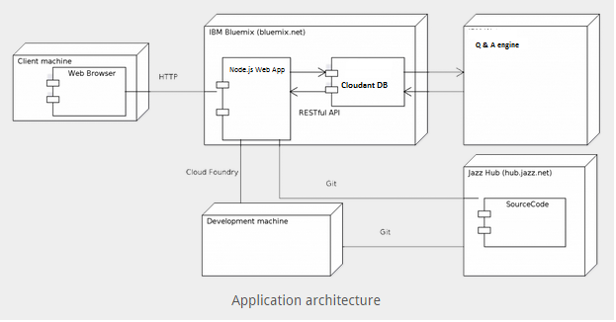
System Design

Slide 7
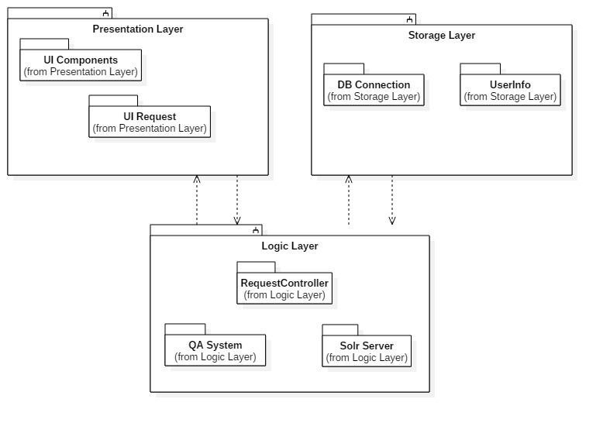
Subsystem Decomposition

Slide 8
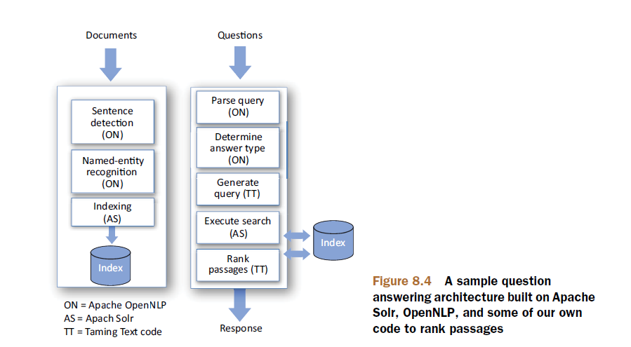
How the QA system works?

Slide 9
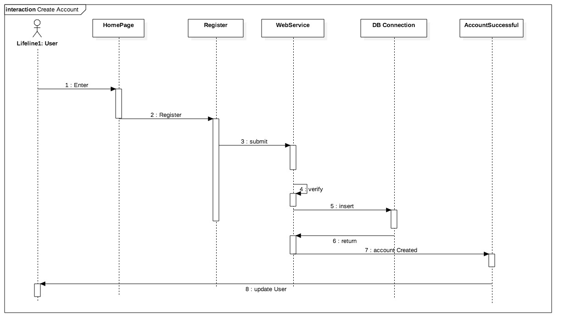
Sequence Diagram – Create Account

Slide 10
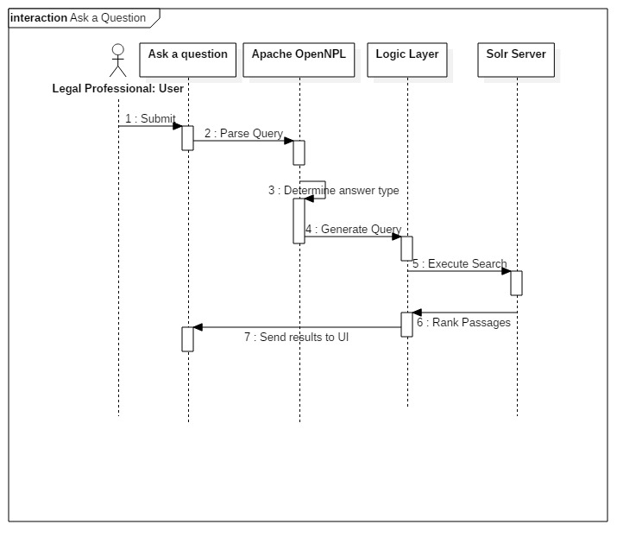
Sequence Diagram – Ask a question

Slide 11
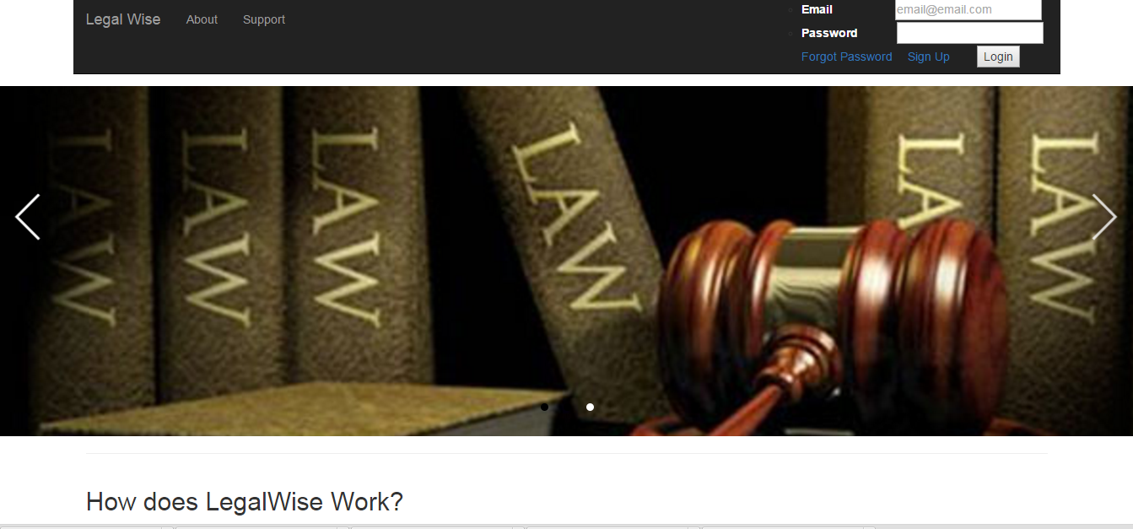
User Interface Design – Home Page

Slide 12
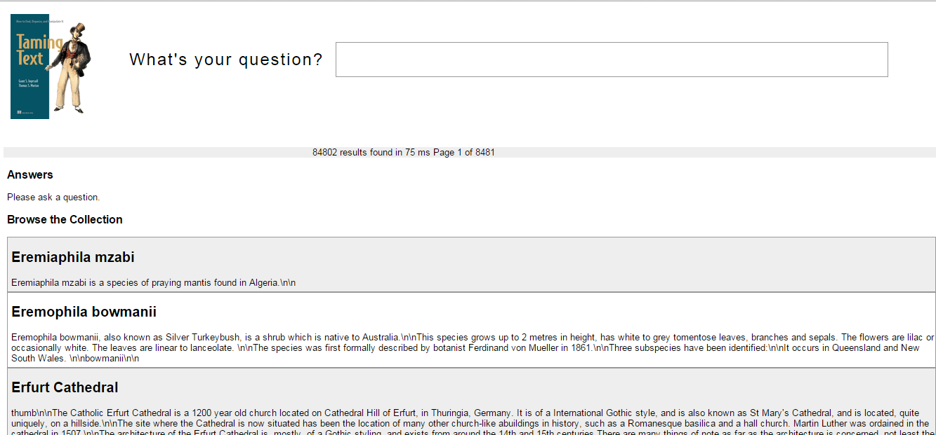
User Interface Design – QA Engine

Slide 13
Summary
LegalWise is a user-friendly web application that answers simple legal questions by analyzing the question and retrieving related documents associated with the answer.
Our web application allows the user to search big databases with legal documents in just a few seconds making the valuable time of our legal professionals more profitable.

